Slide 1
PTT & PAT Data Analyzer
By Junxi Zhu

Slide 2
What it is?
A GUI developed in MATLAB that can automatically analyze experiment data, extract the features, visualize the result and supports finer manipulation to a specific region of data through interactive controls.
Why?
Signal peaks/troughs (features) are found by built-in MATLAB function findpeaks(), which accepts several parameters (e.g., minimum peak height/distance/prominence). Previously, the same set of parameters is used for a subject across all its interventions. However, this would result in features in some region not being properly extracted. Thus, a program that is able to manipulate data in a specific region and meanwhile is easy to is needed use (i.e., the user does not need to know how the underlying code works and is able to perform a desired manipulation with a few button clicks). This is exactly what this GUI program can provide.

Slide 3
Advantages:
Able to perform fine manipulation to a specific region of the data in a few clicks
Able to perform easy visual check on the quality of the extracted features
Results are dynamically updated via diagrams when features are modified
Save/Load allows restoring previous progress
Modular code structure allows easy integration of code from other people as well as upgrade to existing functionalities

Slide 4
Modular Code Structure
The main analysis loop consists of roughly four steps:
Find candidate features for each signal
Remove unwanted features and pair the remaining features to each beat
Find ICG B-point and PPG signal foot
Calculate PTT/PAT from extracted signal features

Slide 5
Signal Hierarchy
Since eventually PTT/PAT/I-J intervals will be correlated to SP/DP, a beat is thrown away if SP/DP cannot be reliably detected in that beat. After SP/DP are extracted, they are used to filter the previously found candidate ECG peaks to find out the real ECG R waves. This is achieved by looping through all the beats that have extracted SP/DP and for each of these beats, look for an ECG peak that is within a specific distance from the DP location in that beat. If found, that ECG peak (R wave) is paired to that beat; if not, NaN will be used. Then ECG R waves are used to filter the BCG signal via exponential averaging. Similarly, extracted ECG R waves are further used to extract ICGdzdt peaks/troughs, BCG peaks/troughs (I/J wave) and PPG signal peaks/troughs. It can be seen that a change in the SP/DP detection will influence feature detection in all the other signals while a change to ECG R waves detection affects all the other signals except BP. In the extreme case, a change to finger PPG feature detection only affects itself. In this sense, all eight signals essentially form a hierarchical relationship (see next page) and the program make use of this feature to eliminate unnecessary calculations and thus to save computational time.

Slide 6
Signal Hierarchy
BP
ECG
BCG
ICGdzdt
Finger PPG
Ear PPG
Foot PPG
Toe PPG
Code:
1
2
3
4
With this in mind, we can assign a number to each of the signal (later used as entry code) to indicate its hierarchical level.

Slide 7
Modular Code Structure
function []=analyze(entryCode)
if entryCode <= 1
findCandidateFeature(BP)
pairFeature(BP peaks, BP troughs)
elseif entryCode <= 2
findCandidateFeature(ECG)
pairFeature(BP troughs, ECG peaks)
expMA(BCG)
elseif entryCode <= 3
findCandidateFeature(ICGdzdt)
pairFeature(ECG peaks, ICGdzdt peaks)
findBPoint(ICGdzdt)
elseif entryCode <= 3
findCandidateFeature(BCG)
pairFeature(ECG peaks, BCG peaks)
pairFeature(ECG peaks, BCG troughs)
elseif entryCode <= 4
findCandidateFeature(finger PPG)
pairFeature(ECG peaks, finger PPG peaks)
pairFeature(finger PPG peaks, finger PPG troughs)
findSignalFoot(finger PPG)
…… same for ear/foot/toe PPG
end
Calulating PTT/PAT/I-J interval…
Plotting…
Now we can add another parameter (entryCode) to the main analysis loop, indicating which signal is triggering the loop. At the initial run, entryCode is set to zero so that all the procedures in the loop will be gone through. Later when the user modifies a signal, the code of that specific signal will be passed as the entryCode to the analyze() function so that only the necessary steps are executed.

Slide 8
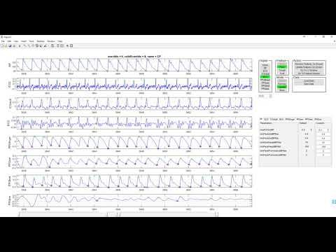
Demonstration – Scrolling

Slide 9

Demonstration – Zooming

Slide 10
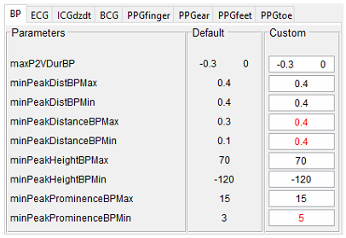
Parameter Panel
Controls the parameters passed to findpeaks() as well as parameters used for pairing process. Custom value that is different than the default value is marked in red.

Slide 11
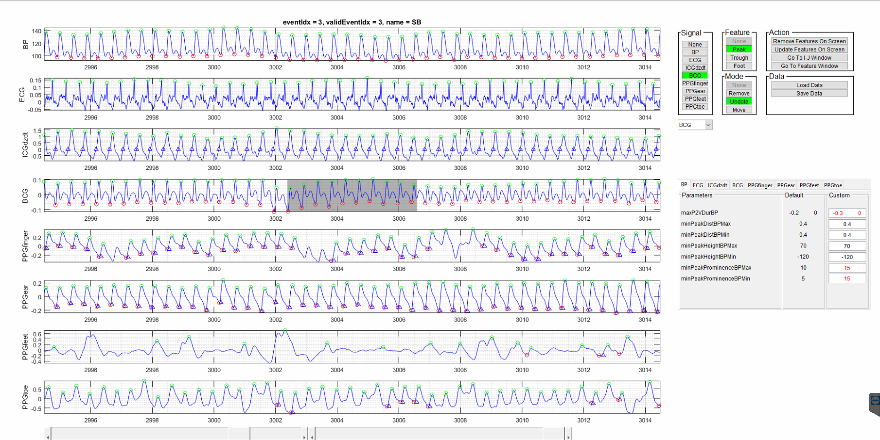
Sample Interface
Signal Selector
Mode
Selector
Feature Selector
Action Selector
Signals
Features
Intervention Info
Save/Load
Custom
Parameters
Selected Window
Reference Signal Selector
Scroll Slider
Zoom Slider

Slide 12
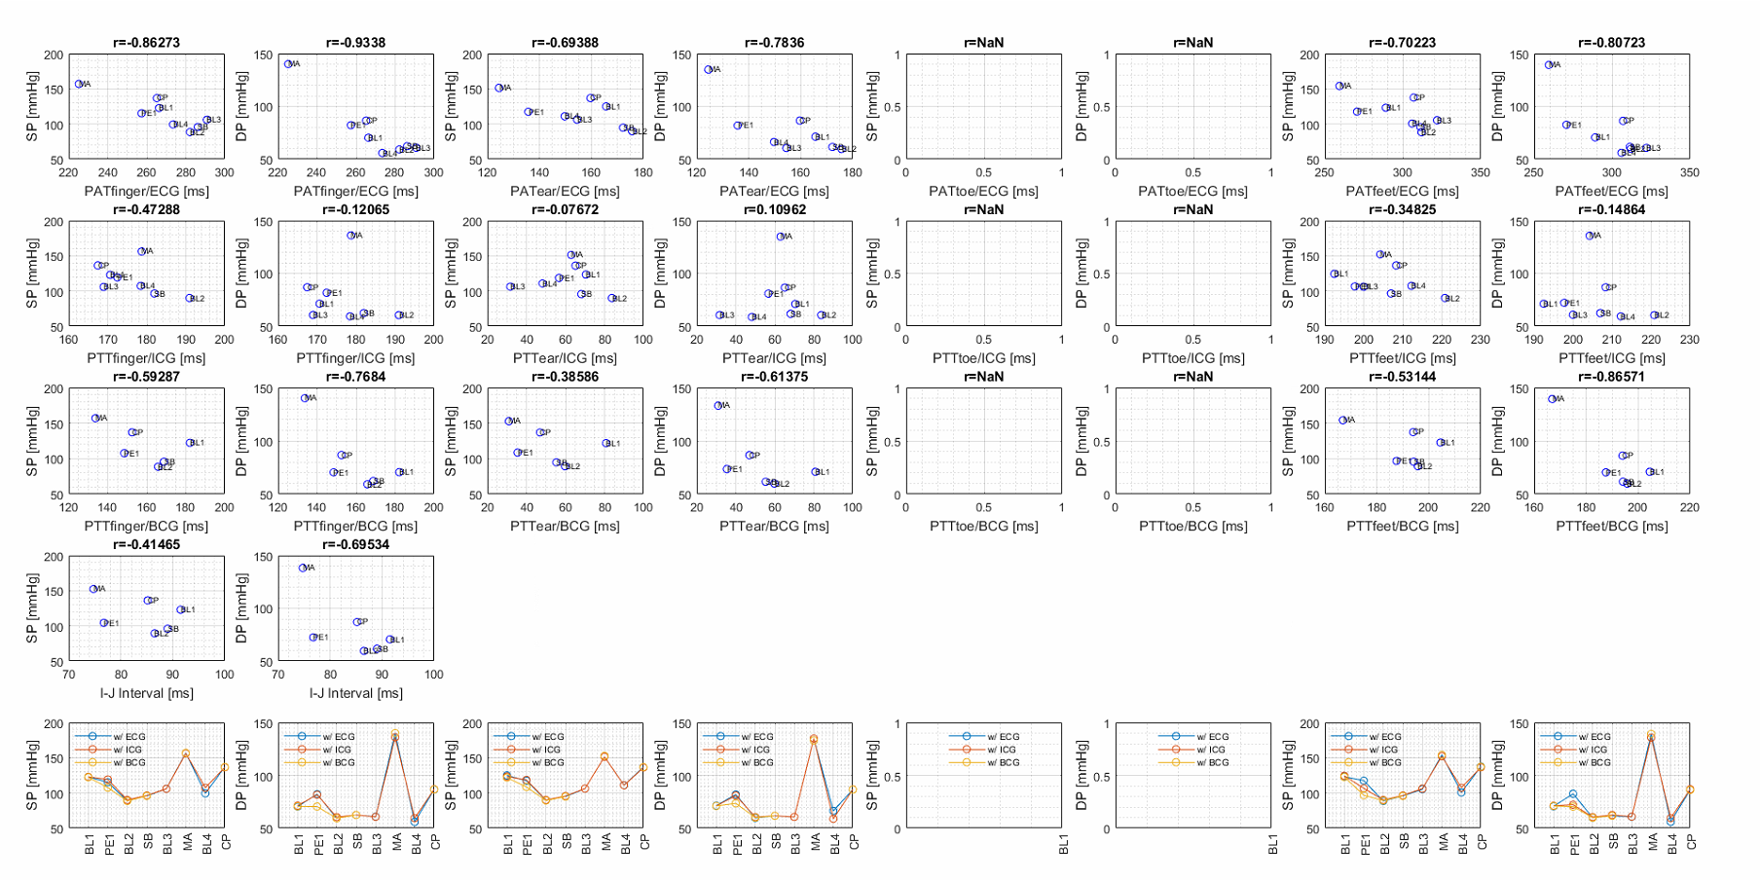
Sample Interface
Results are gathered and shown in different diagrams

